Slide 1



Getting started with
Angular 2

Slide 2
Schedule
Introduction
Angular CLI
Basic Concepts
Demo
Intermediate Concepts
Demo
Advanced Concepts
Next Steps
Notes:
Introduction (3min)
Terminology (2 min)
Angular CLI (3 min) - explain from the document
Demo with CLI commands (10 min)
Basic Concepts (12 min)
Components (2 min)
Templates (1 min)
Modules (5 min)
Data Binding (one way) (4min)
Demo
Intermediate Concepts (12 min)
Directives (2 min)
Pipes (2 min)
Services (3 min)
Dependency Injection (5 min)
Demo
Advanced Concepts

Slide 3
Introduction

Slide 4
Angular 2 is the newest version of Google’s massively popular MVC framework for building complex single page applications for browsers (and beyond).
Notes:
Explain what is a single page application.
A single-page application (SPA) is a web application or website that fits on a single web page with the goal of providing a user experience similar to that of a desktop application.
Highlight why we are using a JS framework ?
Usage in Enterprise application

Slide 5
TypeScript is a strict syntactical superset of JavaScript, and adds optional static typing to the language.
Notes:
Usage of Types
Relate to Enterprise apps
Familiarity

Slide 6
Angular CLI

Slide 7
A command line interface for Angular 2 developed by the Angular team

Slide 8
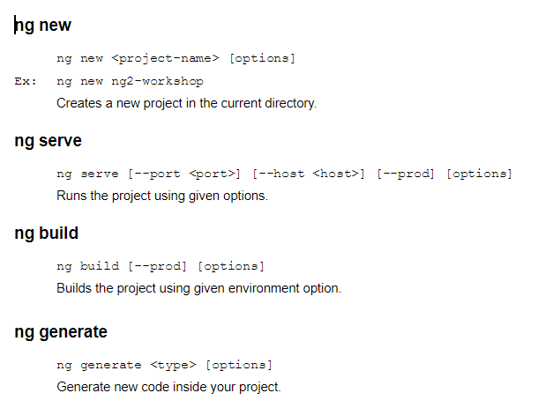
Angular CLI Reference

Slide 9
Basic Concepts

Slide 10
Component
Decorator @Component
Controls a patch of screen called a view
Get initialized, updated, destroyed as the user moves through the application
Component lifecycles

Slide 11
Component
@Component({
selector: 'hello',
templateUrl:'./hello.component.html',
styleUrls: ['./hello.component.css']
})
export class HelloComponent {
....
}
Usage:
...
<hello></hello>
...
Notes:
Usage of Selector

Slide 12
You define a component’s view with its companion template. A template is a HTML that tells Angular how to render the component.
Notes:
Generate the first component using CLI ng g c hotel-grid
And discuss about the @Component decorator

Slide 13
Template
<div>
<h4>
This is Hello Component
</h4>
....
</div>
....

Slide 14
Angular apps are modular and Angular has its own modularity system called Angular module or NgModule.

Slide 15
Module
Decorator @NgModule
Every Angular app has at least one module class, the root module
Most medium to large scale apps have feature modules in addition to the root module

Slide 16
Module
@NgModule({
imports: [CommonModule],
declarations: [HelloComponent],
exports: [HelloComponent],
providers: [HelloService]
})
export class HelloModule {
....
}

Slide 17
Declarations define which Components, Directives and Pipes belong to the module
Notes:
Can be Components, Directives or Pipes
Define which Components, Directives and Pipes belongs to the module
Those are visible inside the module

Slide 18
Exports define which declarations of this module should be visible to other modules that import this module.

Slide 19
Imports define external modules that should be imported into the current module (Dependant modules).
Notes:
Array of Modules
Make exported declarations of those modules available in this module

Slide 20
Providers define which services are being used in this module.
Notes:
Service providers to be used inside this module
Used for dependency injection

Slide 21
Data Binding
How Angular communicates with HTML template
One way data binding
Two way data binding
Event binding

Slide 22
One Way Data Binding
Binding data from data source to target or from target to data source.
But not in both ways
{{expression}} [target]="expression"

Slide 23
Event Binding
Binding events of views to the controller
<button (click)="onSave()">Save</button>

Slide 24
Demo

Slide 25
Intermediate Concepts

Slide 26
Directive
Decorator @Directive
A directive provides instructions to the Angular Renderer on how to render HTML elements on the page
Three types of directives,
Component
Attribute Directive
Structural Directive

Slide 27
Attribute directives change the appearance or behavior of an DOM element
<div highlight>{{hotel.name}}</div>

Slide 28
Structural directives change the DOM layout by adding and removing DOM elements
<div *ngIf="hotel">{{hotel.name}}</div>

Slide 29
Pipe
Decorator @Pipe
A pipe takes in data as input and transforms it to a desired output.
@Pipe({ name: “currency” })
export class CurrencyPipe {
....
}
<div>{{room.price | currency:”USD”}}</div>

Slide 30
Service
Decorator @Injectable
Service is a broad category encompassing any value, function, or feature that your application needs
@Injectable()
export class HelloService {
....
}

Slide 31
Dependency Injection
Angular uses dependency injection to provide new components with the required services
When creating a component, Angular first asks an injector for the required services

Slide 32
Dependency Injection
The injector maintains a pool of service instances.
When a service is being requested, injector will find it from the pool and deliver it.
If it is not available injector will create an instance and put it to the pool first.

Slide 33
Dependency Injection
Injector
HttpService
DataService
HelloService
HotelService
Service must be provided in the component or in the module that component belongs to
HelloModule
….
provides: [HelloService],
….
HelloComponent
constructor(HelloService) {....}

Slide 34
Demo

Slide 35
Advanced Concepts

Slide 36
Forms
Two way data binding - NgModel
Model Driven Forms
Template Driven Forms
Dynamic Forms
Custom Form Controls
Validating forms

Slide 37
Routing
Primary Routing
Auxiliary Routing
Lazy Loading
Pre-loading
Child Routing
Route protection - Auth Guard

Slide 38
Misc
Subjects and asynchronous data handling
Advanced bootstrapping
Lifecycle hooks
Dependency injection hierarchy
AOT vs JIT
Compiling modules and publishing to NPM

Slide 39
Next Steps

Slide 40
Injector
Pipe
Service
Service
Directive
Dependency Injection
Component
Data view formatting
Appearance or Structure Manipulation
Property Binding
Event Binding
Template

Slide 41
References
https://angular.io/docs
https://github.com/angular/angular
https://github.com/angular/angular-cli/wiki
https://material.angular.io/
https://github.com/angular/material2

Slide 42
Thank You

